Slide 1
Getting Started with Files & Attachments
Spitfire Project Management System

Slide 2
Overview
How to Attach Files
Drag and Drop
Add Files Tool
Doc Attach Tool
Working with Files
View Files
Export/Download Files
Re-sequence Files
Add Notes to Files
Change Filenames
Adding Files from Email
Forwarding Emails
Check-in/Check-Out
When You Can Edit
Save to Check In
Files on the Project
Files in the Catalog

Slide 3
Definition of “File”
Documents are Spitfire Documents
Files are created outside of Spitfire and uploaded into Spitfire’s Catalog
For example:
.PDF
.DOCX
.XLSX
.TIF
.JPG
.HTM
.MDI
.DWG
.DWF

Slide 4
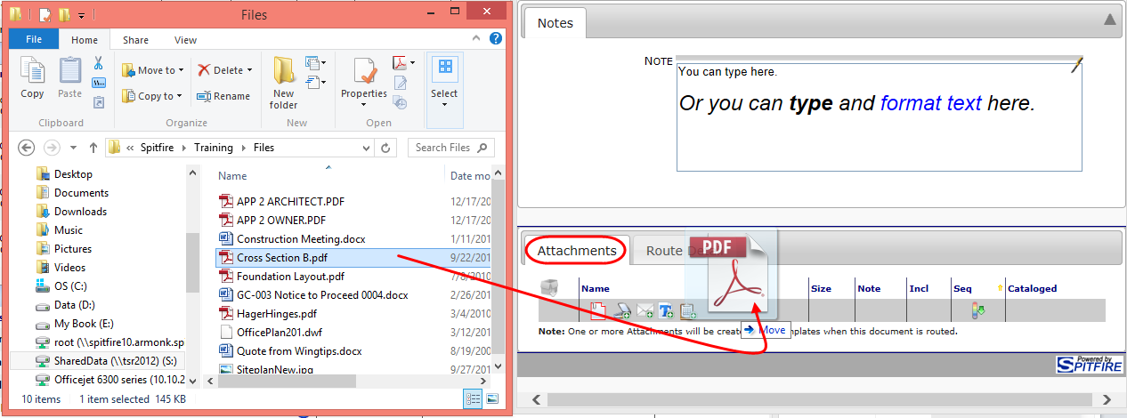
Attach Files to Spitfire Documents
Drag and Drop Files to the Attachments tab

Slide 5
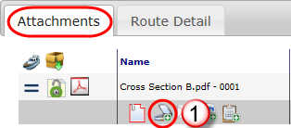
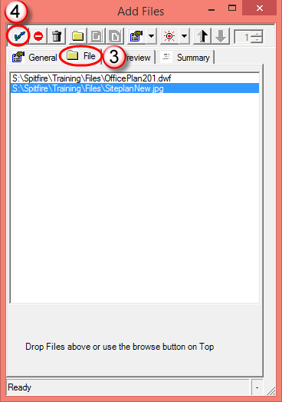
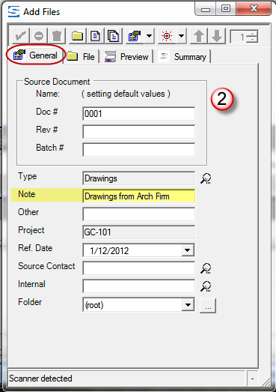
Attach Files to Spitfire Documents
Use the Add Files tool from the Attachments tab.

Slide 6
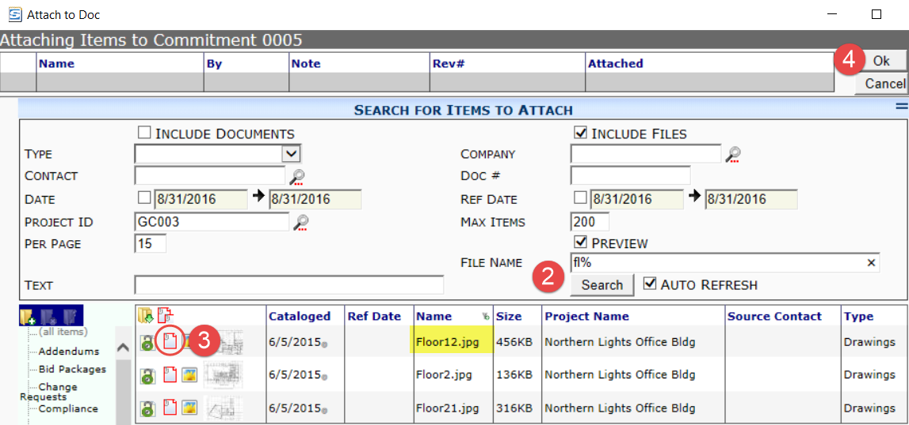
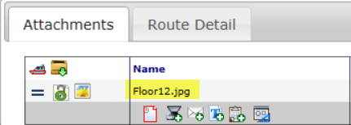
Doc Attach Tool
You can also attach a file that is already in the Catalog onto your document.

Slide 7
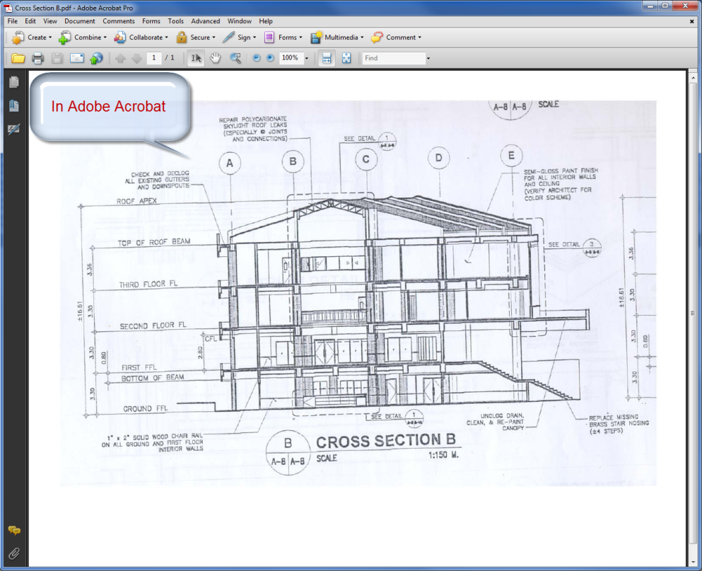
View an Attached File
Click the icon to view the file. Icons may be different for different file types.

Slide 8
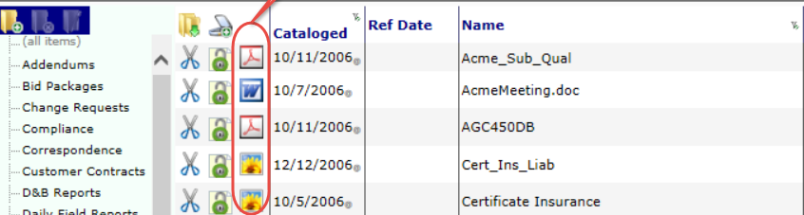
View Files
You can view files from documents, Project Dashboards and the Catalog Dashboard.

Slide 9
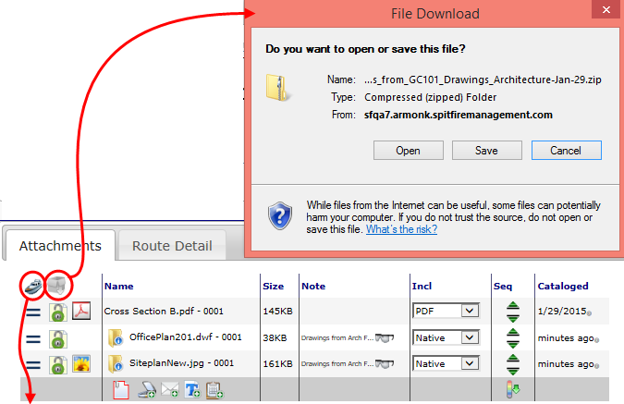
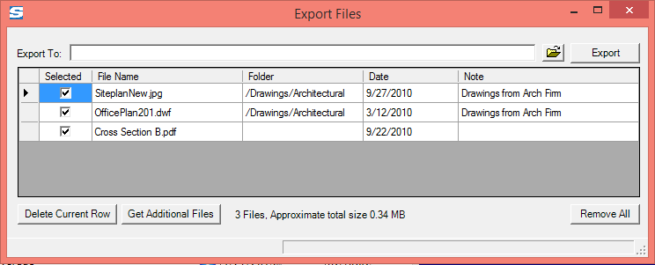
Export/Download Attached Files
Two choices:

Slide 10
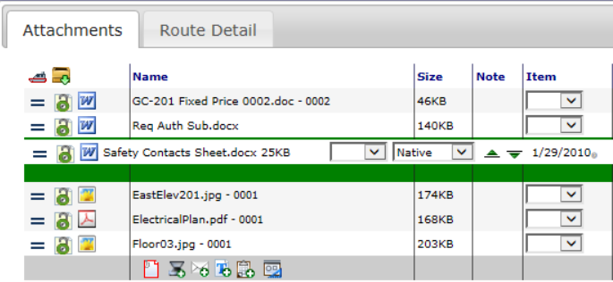
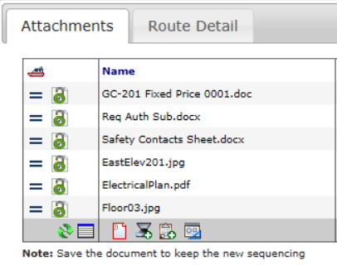
Attachment Sequence
To reorder Attachments, place your cursor in the first column, then drag up or down.
Save the document to keep the new sequencing.

Slide 11
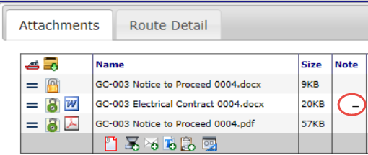
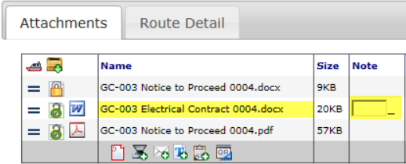
Notes for Files
On the Attachments tab, click in the Note field then type your note for that file.

Slide 12
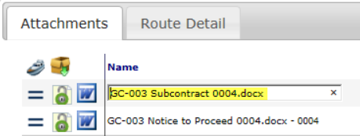
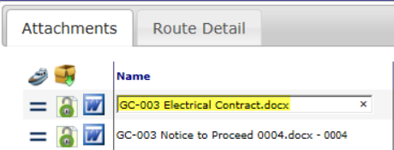
In-place Editing of Filenames
Click on a filename in order to edit it, wherever filenames are listed.

Slide 13
Attach File from an Email
First, drag a file that is attached to an email to your desktop.
Then drag the file to your Attachment tab (or use the Add Files tool).

Slide 14
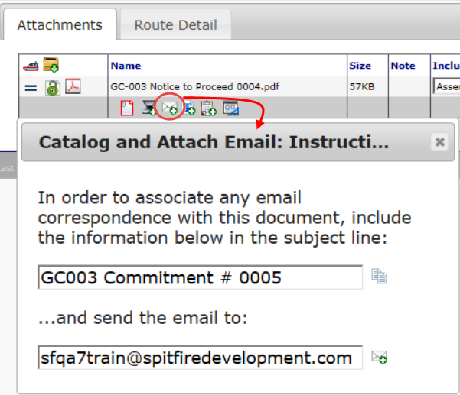
Forward Any Email to Spitfire
If you want to forward an email to your Spitfire site and have it attached to a specific document, click the “envelope” icon on that document to get the subject line and email address that you should use. For example:

Slide 15
Checked-In / Checked-Out
If you have permission to edit a file, click on the file type icon to edit the file.
You can edit the file if it is “checked in”—indicated by the green lock.
If the file is “checked out”—indicated by the red lock—you can’t edit it at the moment.

Slide 16
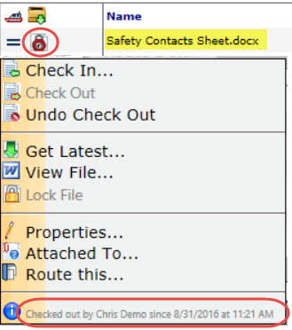
Checked-Out
Click the red lock icon to see who has the file checked out and since when.

Slide 17
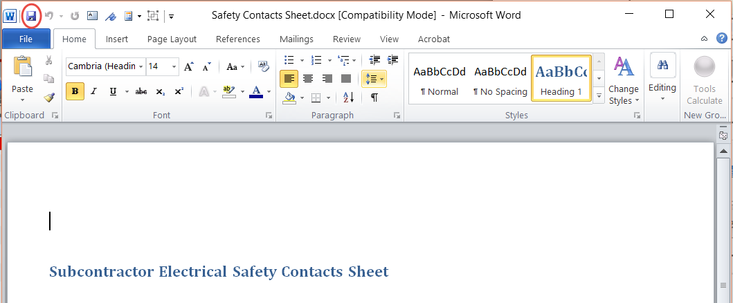
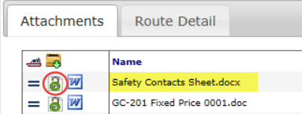
Save and Check In
When you edit an attached file and then save your changes, the file is automatically checked in.

Slide 18
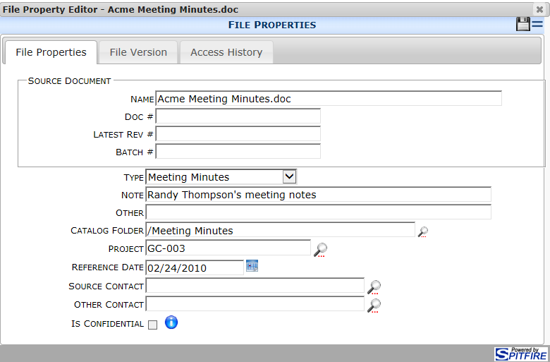
File Properties
Click the Lock icon to access the File Options menu
Select File Properties to view the file’s information including File Versions and Who Accessed the file.
Previous Versions of a File are available from the File Properties | File Version tab.

Slide 19
Files on the Project Dashboard
Files attached to documents on a project all appear on that project’s Files list.
The Files part also lists files that have been uploaded directly into the Project Dashboard through the Add Files tool.

Slide 20
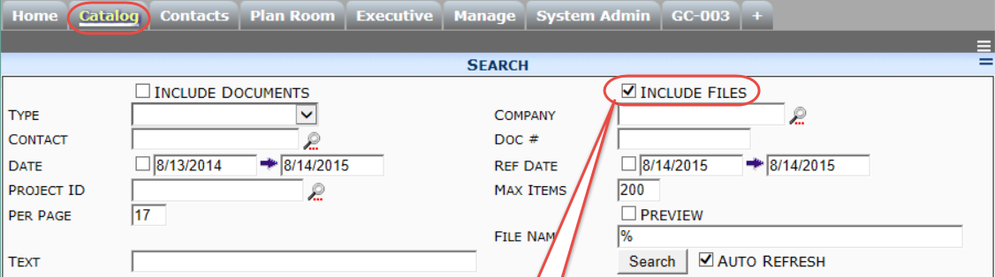
Search for Files in the Catalog
On the Catalog Dashboard, you can use filters to search for files, but only those files to which you have been given access.

Slide 21
Files on the Catalog
When files are filtered by project, results are identical to the Files part on that Project Dashboard.

Slide 22
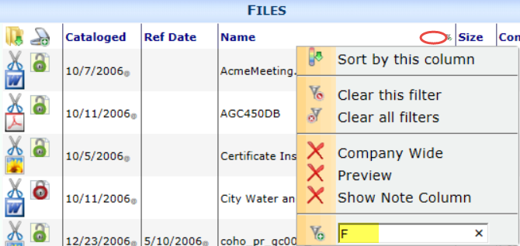
Filter by Filename
On the Attachments tab, Project File part and Catalog File part, you can filter files by name.

